Slide 1




PROJECT
" Strengthening the Competitiveness and Extraversion of cross-border
BUSiness by implementing INNovative and Specialized Actions"
INNOBUS
IN FOCUS ASSOCIATION
Project Beneficiary ( PB 4)
 | The project is co-financed by the European Fund for Regional Development and by national funds of the countries participating in the Cross-Border Cooperation Program INTERREG V - A Greece - Bulgaria 2014-2020

Slide 2

Final event
Provision of business consultancy for entrepreneurs in the cross-border region
10.03.2023, Blagoevgrad

Slide 3
Scope of business consulting for entrepreneurs in the cross-border region December 2022 – March 2023
Financial consulting - assistance in preparing a business plan, pricing, lending, etc.
Strategic planning and management - search for markets, inclusion in networks and clusters, market research , competition, etc.
Marketing and PR consulting - promotion of the company's activities by using the possibilities of digital, VR and traditional marketing, public relations, media and presence in social networks and using other modern methods and tools.
HR consulting - practical advice and methods for recruiting, interviewing .
Legal consultations – legal forms, regimes for registration and licenses, regulatory requirements for accountability, labor law issues, etc.
Project funding opportunities – programs that will finance the sector that is selected and other funding opportunities.

Slide 4
TYPES OF BUSINESS PACKAGES
One-off business consultations - on a specific case: on the possibilities of applying with a project for grant funding under a specific program, on developing a marketing strategy, on human resources management, on implementing a certain management model, on an innovative product, organizing a marketing campaign, applying for credit and others.
Complex/packaged business services :
  For a start-up business - Consultations to clarify and develop a new business idea, assistance in formulating a mission, vision, goals, budgeting the initial investment and developing an initial business plan and other services depending on the specific business
  For existing business - Analysis of the current state of the business, identification of opportunities for development and increase of profits, solving specific business cases, identifying the main priorities and next steps, implementing innovative products and services, entering international markets, inclusion in clusters and business networks, etc.

Slide 5

TARGET GROUPS
Young people up to 29 years old - potential business entrepreneurs who plan to start their own business or improve and develop their existing business

Slide 6
ACHIEVED RESULTS for the period 10.12.2022 – 10.03.2023
Number of consulted young people up to 29 years old - 27
Provided business consultations within 504 hours
Type of business consultation provided:
  Single consultations - 7 young people
  Packaged services – 20 youth
Method of providing consultations: individual business consultations face to face with experts in the office of PB 4 in Blagoevgrad, by phone and online and group consultations.
Number of prepared business plans – 20 pcs.

Slide 7
BUSINESS IDEAS with developed business plans
Shop for children's and maternity clothes
Hotel for dogs
Car repair
Discovery of a pastry shop
Fast food
Guesthouse
Winery
Opening a restaurant
Cheese production
Accounting Office
Real Estate Agency
E-shop
Fashion atelier
Consulting services
FEC
Creation of a construction company
Interior Design and Design
Fitness center
Beauty salon

Slide 8
BUSINESS CONSULTANTS
UNDER THE INNOBUS PROJECT
Rositza Djambazova
Natasha Zarankova
Snezhana Dzhugdanova
Toma Machev

Slide 9

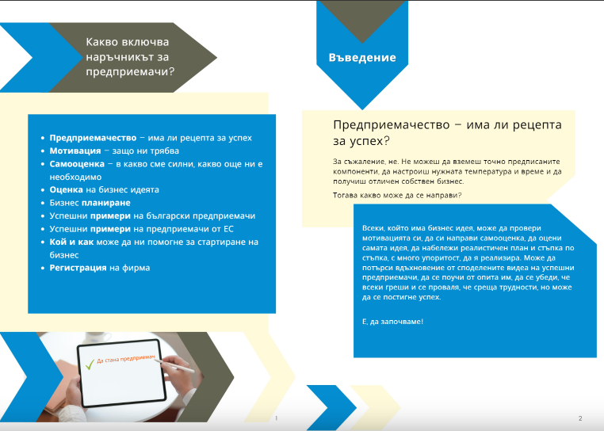
A NEW GENERATION ENTREPRENEURS’ GUIDE
DEVELOPED
https:// issuu.com/innobus_project/docs/innobus _-_ 1cfdd21e010d56

Slide 10

ROSITZA DJAMBAZOVA
Director of Business Incubator - Gotse Delchev,
Entrepreneurship Promotion Centre
Chairman of the Board of the National Network for Business Development
Chairman of the Board of Forum Civic Participation
e-mail: rosi_kd@abv.bg
www.bi-gd.org
The final event is part of the implementation of Activity 2: " Providing business consulting for entrepreneurs in the cross-border region" according to Art. 1, para. 3, item 2 of Service Agreement No. Innobus-U-03-11.10.2022, executed by Gotse Delchev Business Incubator, center for supporting entrepreneurship and financed under the INNOBUS project, co-financed by the European Regional Development Fund (ERDF) and from national funds of the countries participating in the Cross-Border Cooperation Program
INTERREG V - A Greece - Bulgaria 2014-2020.
The contents of this publication are sole responsibility of “In focus” Association and can in no way be taken to reflect the views of the European Union, the participating countries the Managing Authority and the Joint Secretariat

